Slide 1

Improvi
Go, change the world
RV College of
Engineering
Unit 1
Data Modeling using Entity Relationship (E-R) Diagram
Original Content: Ramez Elmasri and Shamkant B. Navathe
Dr. Poonam Ghuli
Associate Professor, Department of CSE
RV College of Engineering, Bengaluru - 59

Slide 2

Contents
Go, change the world
RV College of
Engineering
Conceptual Data Model for Database Design
ER Model Concepts
Entities and Attributes
Entity Types, Value Sets, and Key Attributes
Relationships and Relationship Types
Weak Entity Types
Roles and Attributes in Relationship Types
ER Diagrams - Notation

Slide 3
Overview of Database Design Process
Go, change the world
RV College of
Engineering
Two main activities:
Database design
Applications design
Focus in this chapter on database design
To design the conceptual schema for a database application
Applications design focuses on the programs and interfaces that access the database
Generally considered part of software engineering

Slide 4
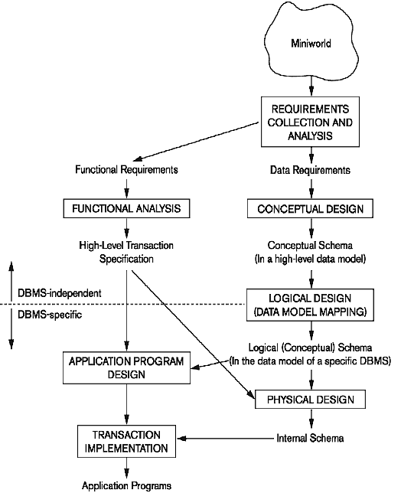
Overview of Database Design Process
Go, change the world
RV College of
Engineering

Slide 5
Entity-Relationship (ER) Model Concepts
Go, change the world
RV College of
Engineering
A popular high-level conceptual data model
Entities and Attributes
Entities are specific objects or things in the mini-world that are represented in the database.
For example the EMPLOYEE John Smith, the Research DEPARTMENT, the ProductX PROJECT
Attributes are properties used to describe an entity.
For example an EMPLOYEE entity may have the attributes Name, SSN, Address, Gender, BirthDate
A specific entity will have a value for each of its attributes.
For example a specific employee entity may have Name='John Smith', SSN='123456789', Address ='731, Fondren, Houston, TX', Gender='M', BirthDate='09-JAN-55‘
Each attribute has a value set (or data type) associated with it – e.g. integer, string, subrange, enumerated type, …

Slide 6
Types of Attributes
Go, change the world
RV College of
Engineering
Simple
Each entity has a single atomic value for the attribute. For example, SSN or Gender.
Composite
The attribute may be composed of several components. For example:
Address(Apt#, House#, Street, City, State, ZipCode, Country), or
Name(FirstName, MiddleName, LastName).
Composition may form a hierarchy where some components are themselves composite.
Multi-valued
An entity may have multiple values for that attribute. For example, Color of a CAR or PreviousDegrees of a STUDENT.
Denoted as {Color} or {PreviousDegrees}.

Slide 7
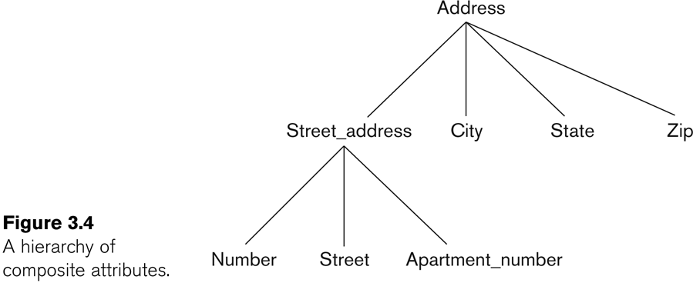
Example of a Composite Attribute
Go, change the world
RV College of
Engineering

Slide 8
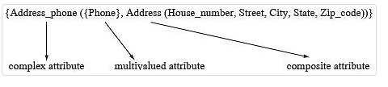
Types of Attributes (cont.)
Go, change the world
RV College of
Engineering
In general, composite and multi-valued attributes may be nested arbitrarily to any number of levels, although this is rare.
For example, PreviousDegrees of a STUDENT is a composite multi-valued attribute denoted by {PreviousDegrees (College, Year, Degree, Field)}
Multiple PreviousDegrees values can exist
Each has four subcomponent attributes:
College, Year, Degree, Field
Complex Attributes
Nested composite and multivalued attributes
Ex. A person has more than one residence and each residence can have a single address and multiple phones

Slide 9
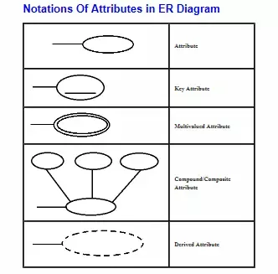
Types of Attributes (cont.)
Go, change the world
RV College of
Engineering

Slide 10
Stored Attributes vs. Derived Attributes NULL values
Go, change the world
RV College of
Engineering
An derived attribute is derived from a stored attribute
Ex. We can derive a man’s age from his birthday.
Null Values - Its meaning includes
An attribute value is not applicable (eg. Previous Degree)
An attribute value is unknown
The value exists but is missing (Eg. Height of a Person)
The value is unknown whether it exists or not (Eg. Home_phone)

Slide 11
Entity Types and Key Attributes
Go, change the world
RV College of
Engineering
Entities with the same basic attributes are grouped or typed into an entity type.
For example, the entity type EMPLOYEE and PROJECT.
An attribute of an entity type for which each entity must have a unique value is called a key attribute of the entity type.
For example, SSN of EMPLOYEE.

Slide 12
Entity Types and Key Attributes
Go, change the world
RV College of
Engineering
A key attribute may be composite.
VehicleTagNumber is a key of the CAR entity type with components (Number, State).
An entity type may have more than one key.
The CAR entity type may have two keys:
VehicleIdentificationNumber (popularly called VIN)
VehicleTagNumber (Number, State), aka license plate number.
Each key is underlined

Slide 13
Displaying an Entity Type
Go, change the world
RV College of
Engineering
In ER diagrams, an entity type is displayed in a rectangular box
Attributes are displayed in ovals
Each attribute is connected to its entity type
Components of a composite attribute are connected to the oval representing the composite attribute
Derived attributes are denoted by dotted ovals
Each key attribute is underlined
Multivalued attributes displayed in double ovals
See CAR example on next slide

Slide 14
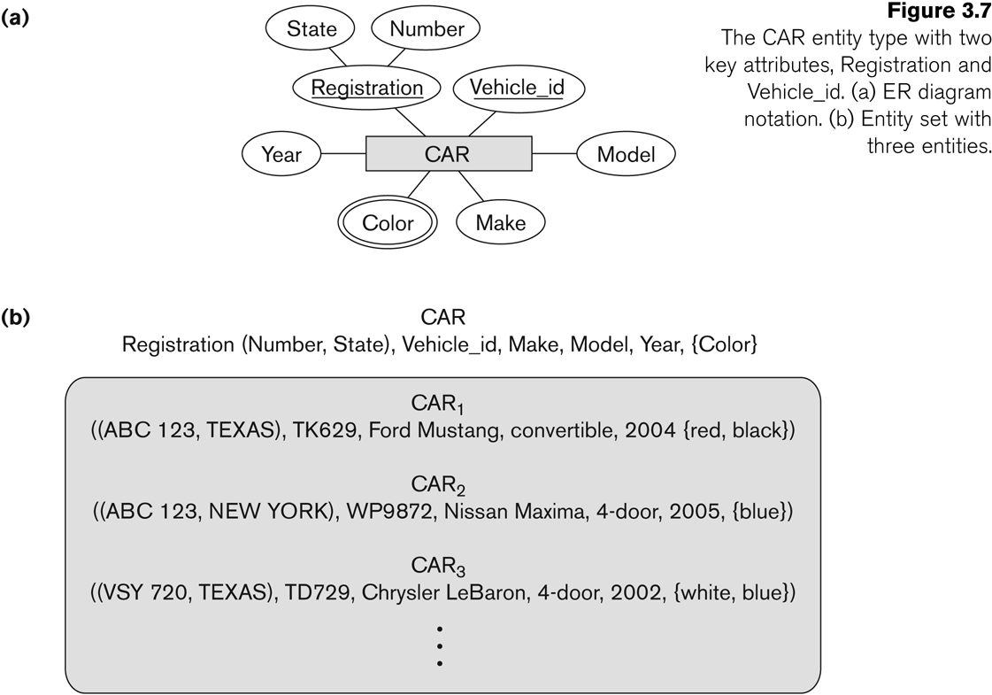
Entity Type CAR with two keys and a corresponding Entity Set
Go, change the world
RV College of
Engineering

Slide 15
Entity Set Value Sets (Domains) of Attributes
Go, change the world
RV College of
Engineering
Each entity type will have a collection of entities stored in the database at a given time
Called the entity set (also called the extension of the entity type)
An entity type describes the schema or intension for a set of entities
Previous slide shows three CAR entity instances in the entity set for CAR
Same name (CAR) used to refer to both the entity type and the entity set
Entity set is the current state of the entities of that type that are stored in the database
Each simple attribute is associated with a value set (or domain of values) [ set of values assigned to that attribute]
Ex. The Age attribute of EMPLOYEE to be the set of integer numbers between 16 to 70

Slide 16
Initial Design of Entity Types for the COMPANY Database Schema
Go, change the world
RV College of
Engineering
Based on the requirements, we can identify four initial entity types in the COMPANY database:
DEPARTMENT
PROJECT
EMPLOYEE
DEPENDENT
Their initial design is shown on the following slide
The initial attributes shown are derived from the requirements description

Slide 17
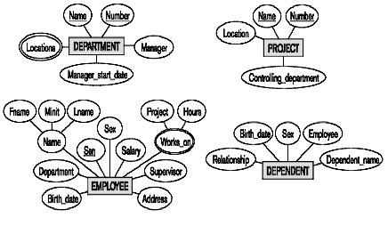
Initial Design of Entity Types: EMPLOYEE, DEPARTMENT, PROJECT, DEPENDENT
Go, change the world
RV College of
Engineering

Slide 18
Refining the Initial Design by Introducing Relationships
Go, change the world
RV College of
Engineering
The initial design is typically not complete
Some aspects in the requirements will be represented as relationships
ER model has three main concepts:
Entities (and their entity types and entity sets)
Attributes (simple, composite, multi-valued, complex, derived)
Relationships (and their relationship types and relationship sets)
We introduce relationship concepts next

Slide 19
Relationships and Relationship Types
Go, change the world
RV College of
Engineering
A relationship relates two or more distinct entities with a specific meaning.
For example, EMPLOYEE John Smith works on the ProductX PROJECT, or EMPLOYEE Franklin Wong manages the Research DEPARTMENT.
Relationships of the same type are grouped or typed into a relationship type.
For example, the WORKS_ON relationship type in which EMPLOYEEs and PROJECTs participate, or the MANAGES relationship type in which EMPLOYEEs and DEPARTMENTs participate.
The degree of a relationship type is the number of participating entity types.
Both MANAGES and WORKS_ON are binary relationships.

Slide 20
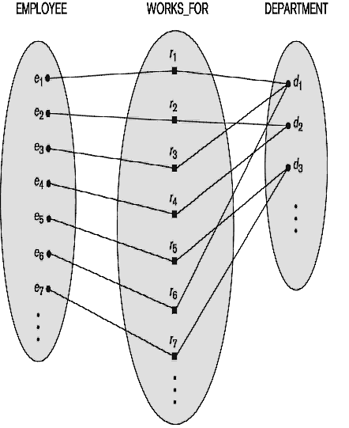
Relationship Instances of the WORKS_FOR N:1 Relationship between EMPLOYEE and DEPARTMENT
Go, change the world
RV College of
Engineering

Slide 21
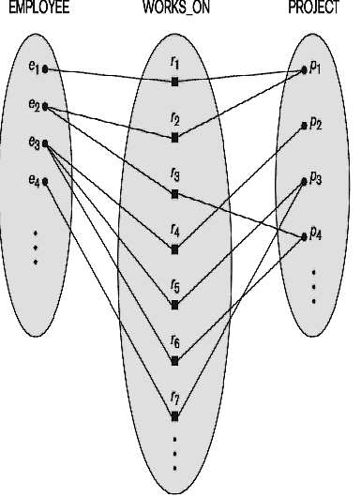
Relationship Instances of the M:N WORKS_ON Relationship between EMPLOYEE and PROJECT
Go, change the world
RV College of
Engineering

Slide 22
Relationship Type vs. Relationship Set
Go, change the world
RV College of
Engineering
Relationship Type:
Is the schema description of a relationship
Identifies the relationship name and the participating entity types
Also identifies certain relationship constraints
Relationship Set:
The current set of relationship instances represented in the database
The current state of a relationship type
In ER diagrams, we represent the relationship type as follows:
Diamond-shaped box is used to display a relationship type
Connected to the participating entity types via straight lines

Slide 23
Refining the COMPANY Database Schema by Introducing Relationships
Go, change the world
RV College of
Engineering
By examining the requirements, six relationship types are identified
All are binary relationships (degree 2)
Listed below with their participating entity types:
WORKS_FOR (between EMPLOYEE, DEPARTMENT)
MANAGES (also between EMPLOYEE, DEPARTMENT)
CONTROLS (between DEPARTMENT, PROJECT)
WORKS_ON (between EMPLOYEE, PROJECT)
SUPERVISION (between EMPLOYEE (as subordinate), EMPLOYEE (as supervisor))
DEPENDENTS_OF (between EMPLOYEE, DEPENDENT)

Slide 24
Discussion on Relationship Types
Go, change the world
RV College of
Engineering
In the refined design, some attributes from the initial entity types are refined into relationships:
Manager of DEPARTMENT -> MANAGES
Works_on of EMPLOYEE -> WORKS_ON
Department of EMPLOYEE -> WORKS_FOR
etc
In general, more than one relationship type can exist between the same participating entity types
MANAGES and WORKS_FOR are distinct relationship types between EMPLOYEE and DEPARTMENT
Different meanings and different relationship instances.
Each entity type that participates in a relationship type plays a particular role in the relationship

Slide 25
Recursive Relationship Type
Go, change the world
RV College of
Engineering
A relationship type where the same entity type participates more than once in the relationship in distinct roles is called recursive relationship
Example: the SUPERVISION relationship
EMPLOYEE participates twice in two distinct roles:
supervisor (or boss) role
supervisee (or subordinate) role
Each relationship instance relates two distinct EMPLOYEE entities:
One employee in supervisor role
One employee in supervisee role

Slide 26
Displaying a Recursive Relationship
Go, change the world
RV College of
Engineering
In a recursive relationship type.
Both participations are same entity type in different roles.
For example, SUPERVISION relationships between EMPLOYEE (in role of supervisor or boss) and (another) EMPLOYEE (in role of subordinate or worker).
In following figure, first role participation labeled with 1 and second role participation labeled with 2.
In ER diagram, need to display role names to distinguish participations.

Slide 27
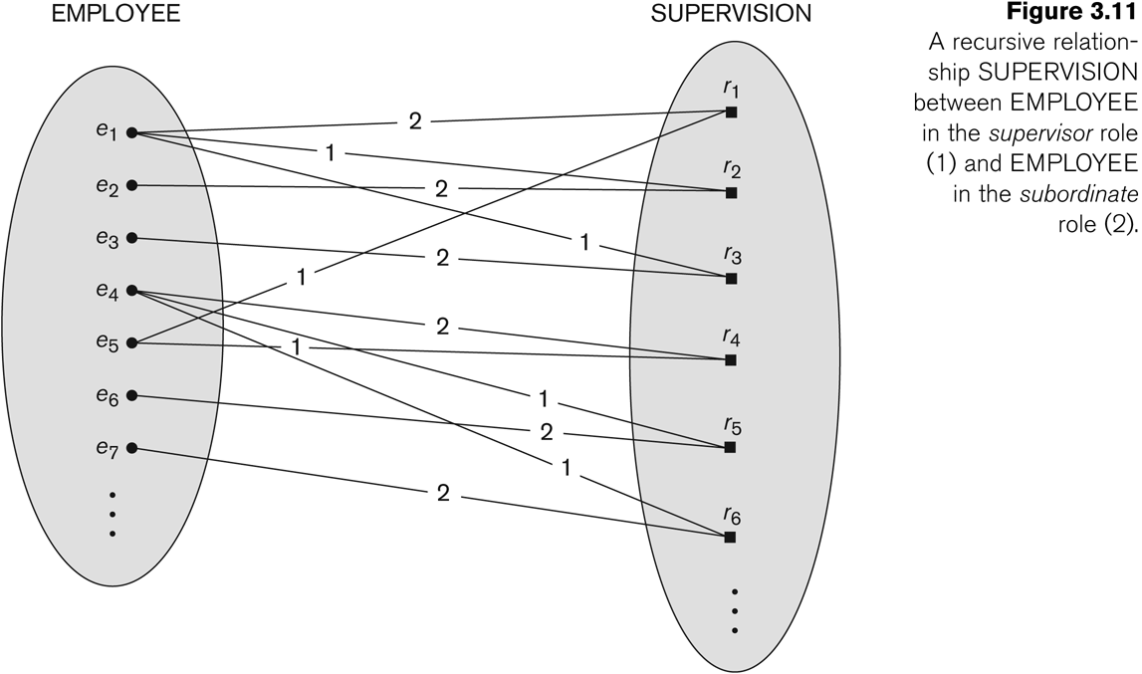
A Recursive Relationship Supervision
Go, change the world
RV College of
Engineering

Slide 28
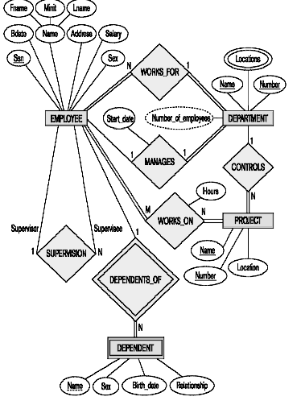
Recursive Relationship Type is: SUPERVISION (participation role names are shown)
Go, change the world
RV College of
Engineering

Slide 29
Weak Entity Types
Go, change the world
RV College of
Engineering
An entity that does not have a key attribute
A weak entity must participate in an identifying relationship type with an owner or identifying entity type
Entities are identified by the combination of:
A partial key of the weak entity type
The particular entity they are related to in the identifying entity type
Example:
A DEPENDENT entity is identified by the dependent’s first name, and the specific EMPLOYEE with whom the dependent is related
Name of DEPENDENT is the partial key
DEPENDENT is a weak entity type
EMPLOYEE is its identifying entity type via the identifying relationship type DEPENDENT_OF
A week entity type and its identifying relationship are distinguished by surrounding their boxes and diamonds with double lines
The partial key attribute is underlined with a dashed or dotted line

Slide 30
Constraints on Relationships (Structural Constraints)
Go, change the world
RV College of
Engineering
Constraints on Relationship Types
Cardinality Ratio (specifies maximum participation)
One-to-one (1:1)
One-to-many (1:N) or Many-to-one (N:1)
Many-to-many (M:N)
Existence Dependency Constraint (specifies minimum participation) (also called participation constraint)
partial participation, optional participation, not existence-dependent
If some entities of an entity type need not participate in any relationship of the relationship type then the participation of that entity type in the relationship type is partial (or optional).
total participation, mandatory participation, existence-dependent
If every entity of an entity type must participate in some relationship(s) of the relationship type then that entity type has total (or mandatory) participation in the relationship type.

Slide 31
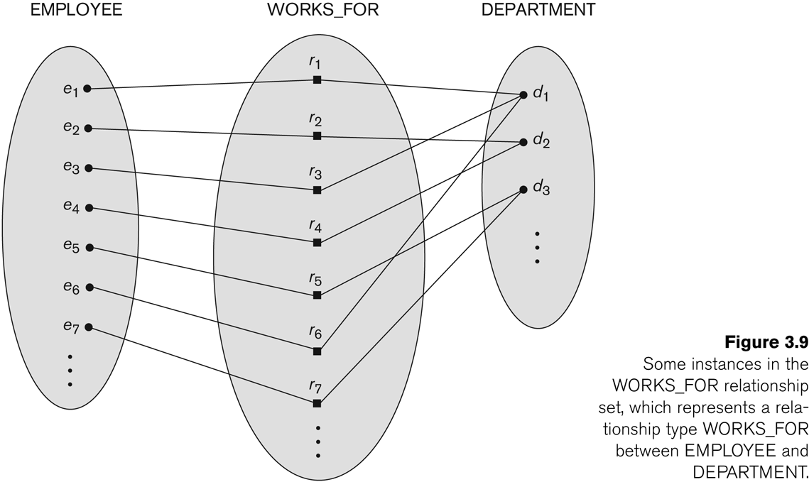
Many-to-One (N:1) Relationship
Go, change the world
RV College of
Engineering

Slide 32
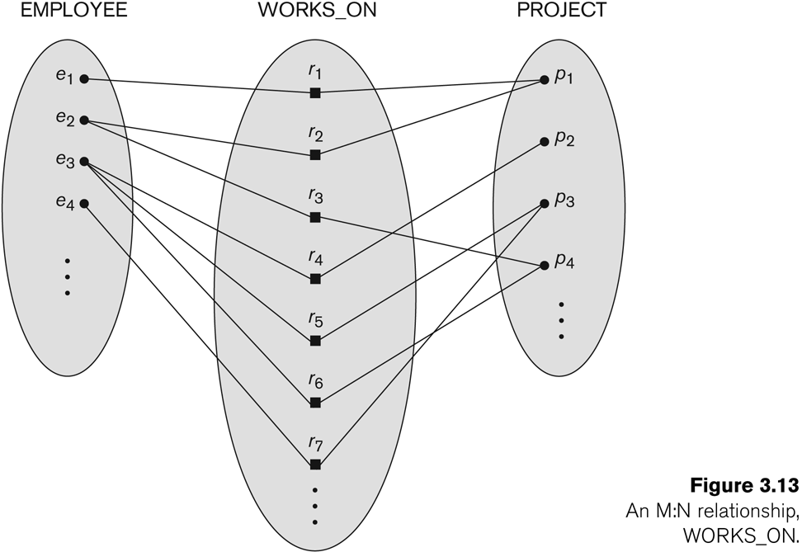
Many-to-Many (M:N) Relationship
Go, change the world
RV College of
Engineering

Slide 33
Attributes of Relationship Types
Go, change the world
RV College of
Engineering
A relationship type can have attributes:
For example, HoursPerWeek of WORKS_ON
Its value for each relationship instance describes the number of hours per week that an EMPLOYEE works on a PROJECT.
A value of HoursPerWeek depends on a particular (employee, project) combination
Most relationship attributes are used with M:N relationships
For M:N relationships, some attributes are determined by the combination of participating entities, not by a single entity. Such attributes must be specified as relationship attributes
In 1:1 relationships, they can be transferred to one of the participating entities
In 1:N relationships, they can be transferred to the entity type on the N-side of the relationship
The decision as to where a relationship attribute should be placed is determined subjectively by the schema designers

Slide 34
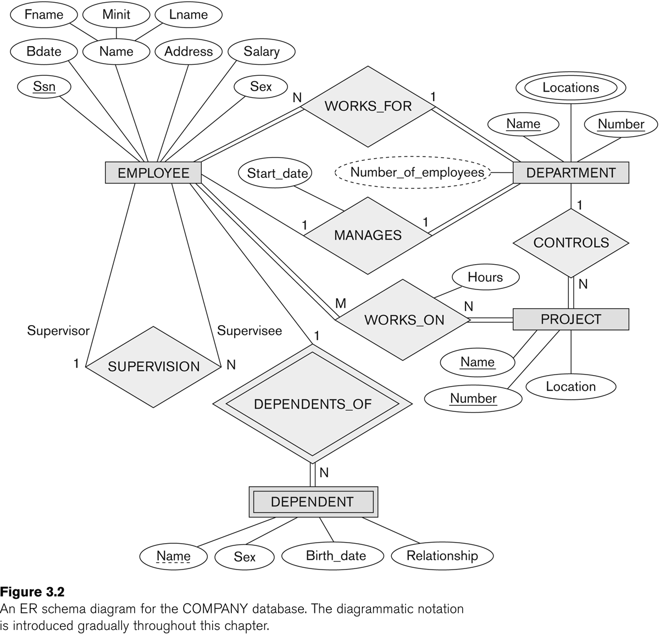
Example Attribute of a Relationship Type: Hours of WORKS_ON
Go, change the world
RV College of
Engineering

Slide 35
Notation for Constraints on Relationships
Go, change the world
RV College of
Engineering
Cardinality ratio (of a binary relationship): 1:1, 1:N, N:1, or M:N
Shown by placing appropriate numbers on the relationship edges.
Participation constraint (on each participating entity type): total (called existence dependency) or partial.
Total shown by double line, partial by single line.
NOTE: These are easy to specify for Binary Relationship Types.
Structural Constraints = Cardinality Ratio Constraints + Participation Constraints

Slide 36
Alternative (min, max) Notation for Relationship Structural Constraints
Go, change the world
RV College of
Engineering
Specified on each participation of an entity type E in a relationship type R
Specifies that each entity e in E participates in at least min and at most max relationship instances in R
Default (no constraint): min=0, max=n (signifying no limit)
Must have min≤max, min≥0, max ≥1
min=0 implies partial participation; min>0 implies total participation
Derived from the knowledge of mini-world constraints
Examples:
A department has exactly one manager and an employee can manage at most one department.
Specify (1,1) for participation of DEPARTMENT in MANAGES
Specify (0,1) for participation of EMPLOYEE in MANAGES
An employee can work for exactly one department but a department can have any number of employees.
Specify (1,1) for participation of EMPLOYEE in WORKS_FOR
Specify (1,n) for participation of DEPARTMENT in WORKS_FOR

Slide 37
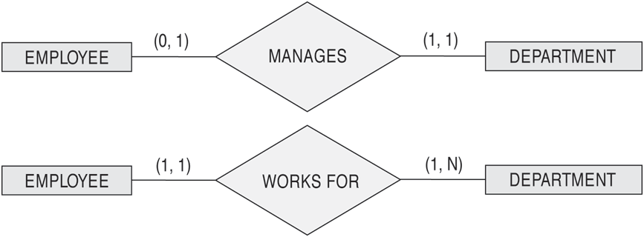
The (min,max) Notation for Relationship Constraints
Go, change the world
RV College of
Engineering
Read the min,max numbers next to the entity type and looking away from the entity type

Slide 38
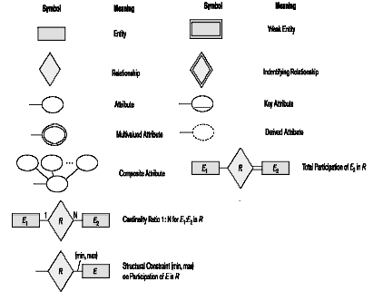
Summary of Notation for ER Diagrams
Go, change the world
RV College of
Engineering

Slide 39

Example of structural Constraints
Go, change the world
RV College of
Engineering
each student must take at least 2 courses and at most 8 courses.
each course must have minimum 4 students and no maximum limit.

Slide 40
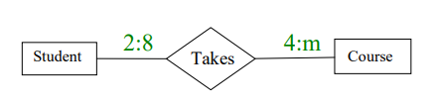
Example of structural Constraints
Go, change the world
RV College of
Engineering

Slide 41
ER-diagram Example 1
Go, change the world
RV College of
Engineering
UPS prides itself on having up-to-date information on the processing and current location of each shipped item.
To do this, UPS relies on a company-wide information system. Shipped items are the heart of the UPS product tracking information system. Shipped items can be characterized by item number (unique), weight, dimensions, insurance amount, destination, and final delivery date.
Shipped items are received into the UPS system at a single retail center. Retail centers are characterized by their type, uniqueID, and address.
Shipped items make their way to their destination via one or more standard UPS transportation events (i.e., flights, truck deliveries). These transportation events are characterized by a unique scheduleNumber, a type (e.g, flight, truck), and a deliveryRoute.
Please create an Entity Relationship diagram that captures this information about the UPS system. Be certain to indicate identifiers and cardinality constraints.

Slide 42
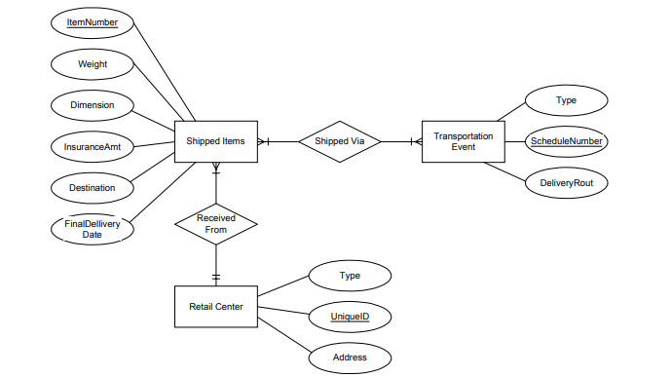
ER-diagram Example 1
Go, change the world
RV College of
Engineering

Slide 43
ER-diagram Example 2
Go, change the world
RV College of
Engineering
You are tasked with creating a database for a coffee shop.
The coffee shop relies on this system to update customer’s orders. Each customer places an order to a barrister.
A barrister receives orders from the customers and makes the specified coffee.
The barrister sends the order to the cashier who ensures that the amount is charged to the appropriate customer. The barrister then delivers the coffee to the customer.
a. Identify the entities and attributes in the scenario.
b. Draw an ERD using the scenario depicted. Be certain to indicate identifiers and cardinality constraints.

Slide 44
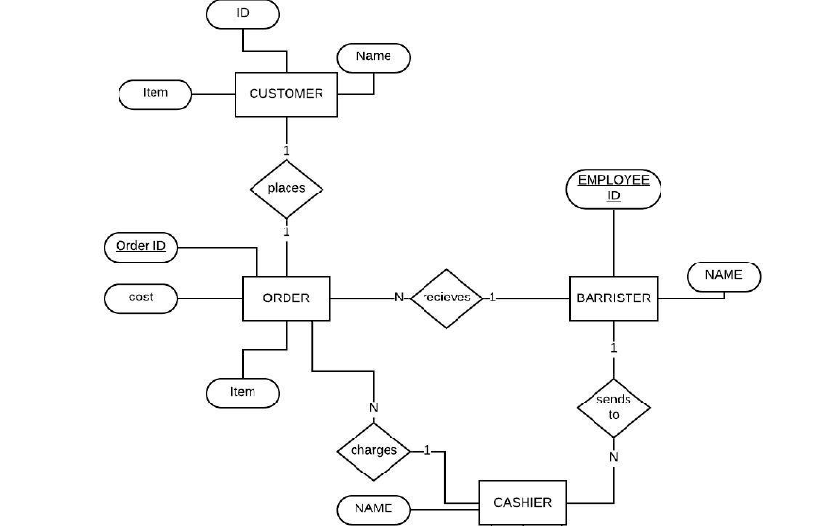
ER-diagram Example 2
Go, change the world
RV College of
Engineering

Slide 45
ER-diagram Example 3
Go, change the world
RV College of
Engineering
A large organization that does automobile repairs must keep track of its repair facilities or garages, the mechanics, and their qualifications in terms of the courses they have taken, the dates they took the courses, and the grade each earned for each course.
Descriptions of these items are as follows:
• Garage: Garage’s identification number and manager’s name
• Mechanic: Employee number and name
• Course: Number, name, and duration (in weeks)
a. What are the entities (fields) in this situation? What are the attributes of each entity?
b. List the entities and their relationships to other entities or other attributes under oneto-
one, one-to-many, many-to-many relationships. For example, “garage”, to “manager” (one-to-one).
c. List the field names to be used in the system. For example, “garage number” is a field
name.
d. Which field names have unique values?
e. Describe this situation using an E-R model.

Slide 46
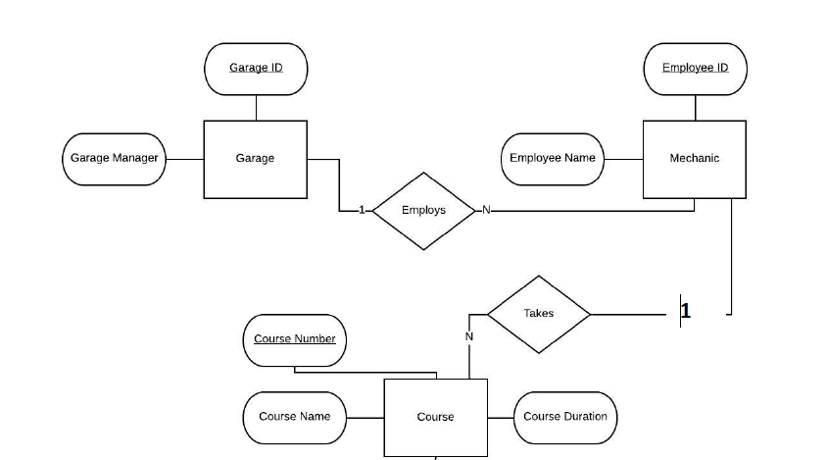
ER-diagram Example 3
Go, change the world
RV College of
Engineering

Slide 47
ER-diagram Example 4
Go, change the world
RV College of
Engineering
Practice ER Diagram Question – A Sample Solution Suppose you are given the following requirements for a simple database for the National Hockey League (NHL):
the NHL has many teams,
each team has a name, a city, a coach, a captain, and a set of players,
each player belongs to only one team, · each player has a name, a position (such as left wing or goalie), a skill level, and a set of injury records,
a team captain is also a player, ·
a game is played between two teams (referred to as host_team and guest_team) and has a date (such as May 11th, 1999) and a score (such as 4 to 2).
Construct a clean and concise ER diagram for the NHL database
List your assumptions and clearly indicate the cardinality mappings as well as any role indicators in your ER diagram.

Slide 48
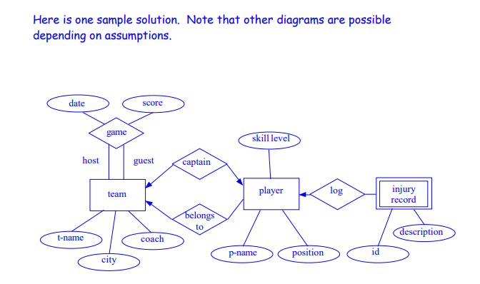
ER-diagram Example 4
Go, change the world
RV College of
Engineering

Slide 49
ER-diagram Example 5
Go, change the world
RV College of
Engineering
A Blood Bank stores blood of various blood groups . Many donors donate blood ,each of different blood group/type. A donor may donate blood more than once and he is identified by a donor id(DID),name, sex, age , address and phone number.
The blood donated by the donor is characterized by blood type , code and cost. Before each donor donates his blood , he is required to register himself as a donor with the receptionist who works at the Blood Bank.
The receptionist is identified by employee id, name , address and phone number
The Blood Banks receives orders for blood from many hospitals for emergency purposes and other surgical requirements and each blood bank issues the same of required blood type.
Each blood bank has it’s own blood bank number(BNO) , issues, orders and blood types stored. The Blood Bank is managed by the blood bank manager who is identified by employee id , name , email_id and phone number.
He is responsible for the proper management of the blood bank . The hospitals are identified by name, address and phone number. Represent this using an ER diagram.

Slide 50
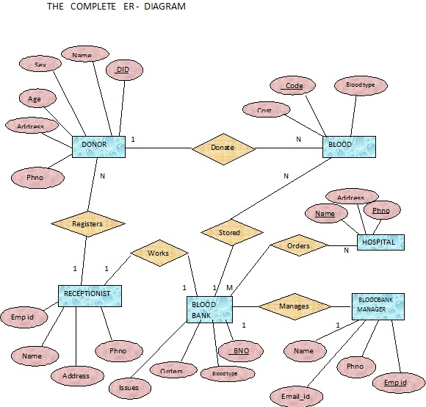
ER-diagram Example 5
Go, change the world
RV College of
Engineering

Slide 51
ER-diagram Example 6
Go, change the world
RV College of
Engineering
Consider the following set of requirements for a MOVIE database in which data is recorded about the movie industry and draw an ER diagram for this application.
Each movie is identified by title and year of release. Each movie has a length in minutes. Each has a production company, and each is classified under one or more genres (such as horror, action, drama, and so forth).
Each movie has one or more directors and one or more actors appear in it. Each movie also has a plot outline. Finally, each movie has zero or more quotable quotes, each of which is spoken by a particular actor appearing in the movie.
Actors are identified by name and date of birth and appear in one or more movies. Each actor has a role in the movie.
Directors are also identified by name and date of birth and direct one or more movies. It is possible for a director to act in a movie (including one that he or she may also direct).
Production companies are identified by name and each has an address. A production company produces one or more movies.

Slide 52
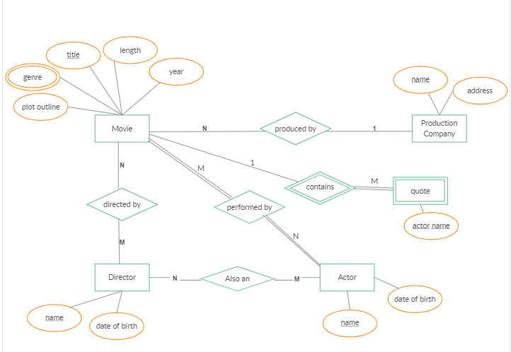
ER-diagram Example 6
Go, change the world
RV College of
Engineering

Slide 53
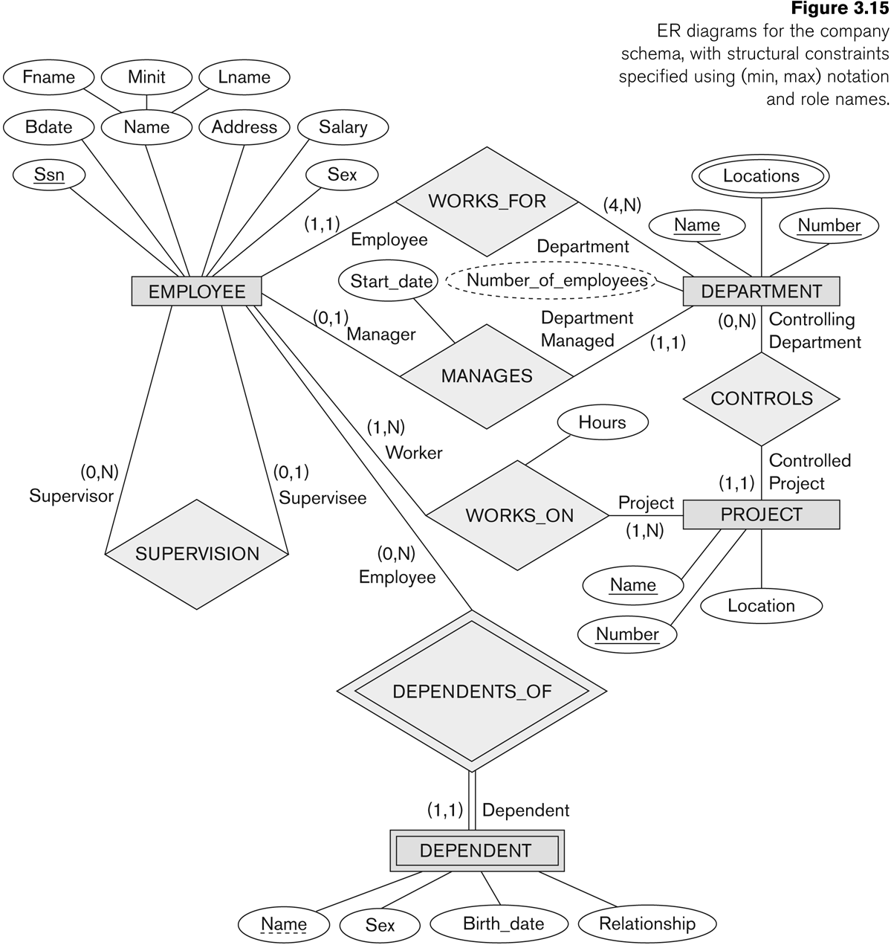
COMPANY ER Schema Diagram Using (min, max) Notation
Go, change the world
RV College of
Engineering

Slide 54
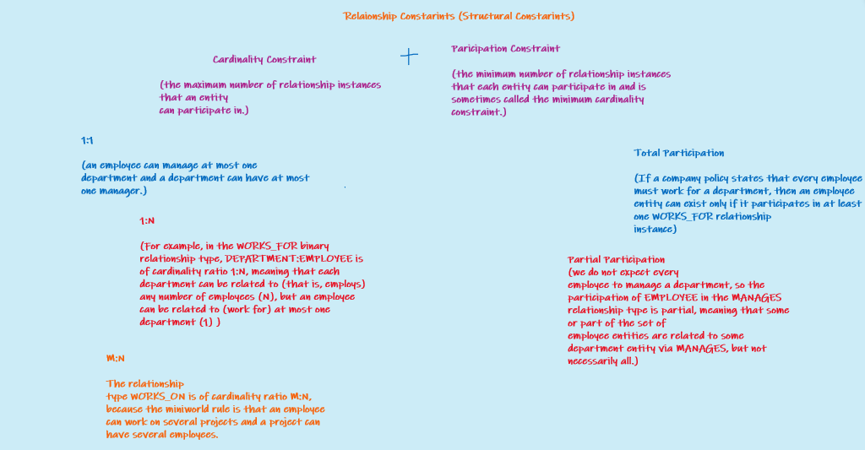
Relationship Structural Constraints
Go, change the world
RV College of
Engineering

Slide 55
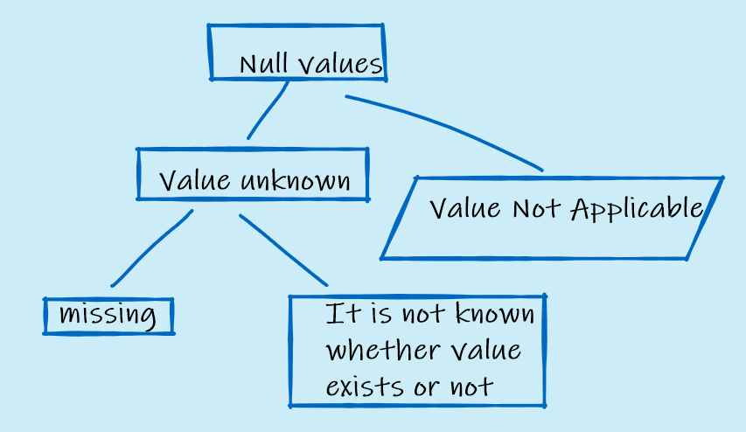
Meaning of Null Values
Go, change the world
RV College of
Engineering

Slide 56
Go, change the world
RV College of
Engineering
Thank YOU

Slide 57
Link to all Classes for this Chapter
Go, change the world
RV College of
Engineering
Class 6
https://drive.google.com/file/d/1QxgC0tCMcbBNpHwMjwN04GJu3-fCMu0F/view?usp=sharing
Class 7
https://drive.google.com/file/d/11wUUC4ByEKm6vDhoohtE_FjWpawbnNms/view?usp=sharing
Class 8
https://drive.google.com/file/d/12nODwZMRVtnPxQSLGRP6hrSKjkCLn4QW/view?usp=sharing
Class 9
https://drive.google.com/file/d/1A2a9IhxyRu4so8uGXs32geqHLAZnjz-t/view?usp=sharing
Class 10
https://drive.google.com/file/d/1KnrM-si9OrhSms5mh5kEJL55gvCpSGMh/view?usp=sharing

